Slide 1
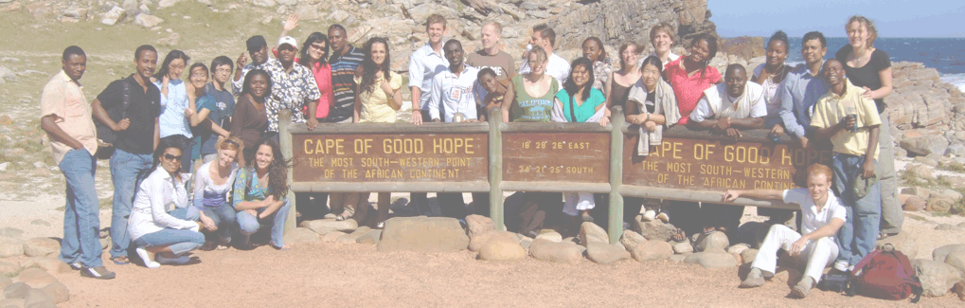




German-South African Rector’s Forum
Workshop I: Study Reform in GER and RSA – Opportunities and Challenges
STUDY REFORM AS CATALYST FOR COLLABORATION: RUB and UWC
Wilhelm Löwenstein

Slide 2
Study Reform as Catalyst for Collaboration: RUB and UWC
1 Partners: RUB and UWC
2 Bologna: RUB-UWC Collaboration at the Masters‘ Level
2.1 Bologna: RUB and the MA in Development Management
2.2 Bochum Programme at UWC
2.3 South African-German Centre at UWC 2008-2013
3 Reforming Doctoral-Training
3.1 Structuring PhD-Programmes
3.2 South African-German Centre at UWC 2014-2018
4 Extending Links: North-North/South-South/North-South
Table of contents

Slide 3
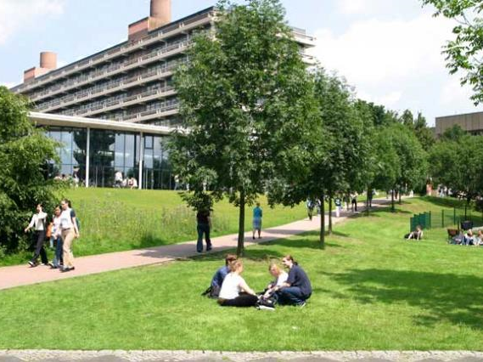

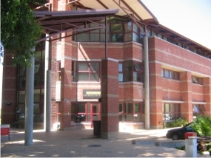
1 Partners: RUB and UWC
Ruhr-University Bochum (IEE)
Ruhr-University Bochum (http://www.rub.de)
Foundation: 1965
Students: ~ 39.000
Academic Staff: ~ 2.900
thereof permanent: ~ 700
Faculties: 20
Centers: 11
University of the Western Cape (ISD and SoG)
University of the Western Cape (http://www.uwc.ac.za)
Foundation: 1959
Students: ~ 15.000
Permanent
Academic Staff: ~ 1.000
Departments: 68
Institutes: 16

Slide 4
2.1 Bologna: RUB-UWC Collaboration at the Masters‘ Level
Early 1990ies – RUB and UWC are members of UNESCO-UNITWIN (together with U Utrecht, U Lund, U Porto, UNAM, U Eduardo Mondlane, UZ), few funding, few activities
1998 – Development-Research Conference at RUB (UNITWIN)
=> incompatible academic programmes
but common research interests
1998 – Design of a development-oriented Masters‘ programme in an environment where there is none but which is on the move towards Bologna
2000 – Start with the MA in Development Management at RUB
(20-25 seats, around 169 mostly international applications)
2002 – Start with the Bochum Programme of Development Management at UWC (15 seats, 60 applications, most from Africa)
Since 2004: 580 applications on average for both programmes
Notes:
4

Slide 5
2.2 Bochum Programme at UWC
Second degree option
Second degree option
MA DevSt
(ISD, UWC)
MA DM
(BoPr at UWC)
MPA
(SoG, UWC)
Recognition of
modules
Recognition of
modules
Exchange of lecturers, joint supervision
Exchange of lecturers, joint supervision
Notes:
5

Slide 6
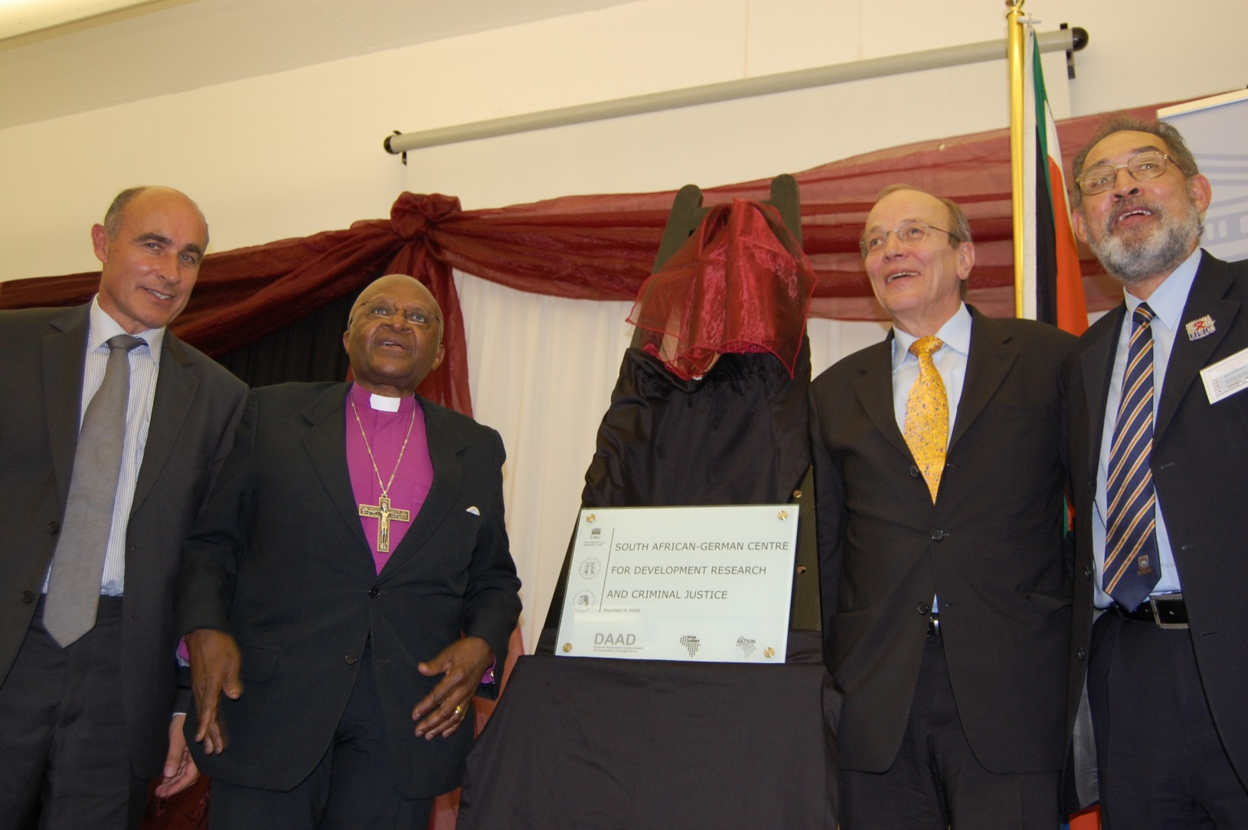
2.3 South African-German Centre at UWC 2008-2013
The Development Research Division at UWC trains future leaders from Sub-Sahara Africa to prepare them to face the challenges of economic, political and social development

Slide 7
2.3 South African-German Centre at UWC 2008-2013
Second degree option
Second degree option
MA DevSt
(ISD, UWC)
MA DM
(BoPr at UWC)
MPA
(SoG, UWC)
Recognition of
modules
Recognition of
modules
Exchange of lecturers, joint supervision
Exchange of PhD-students
PhD DevSt
(UWC)
Structured
PhD IDS (RUB)
PhD Public Admin
(UWC)
Report writing, scientific writing and presentation, team building, German language training, alumni network, tracing studies

Slide 8
3 Reforming Doctoral Training, 3.1 Structuring PhD-programmes
1995-2005: Multidisciplinary, development-oriented research training group at IEE (RUB)
=> good results, growing quality of research training
=> desperate structures (6 faculties involved = 6 exam. regulations
= 6 different degrees)
=> inability to integrate students from outside the German
university system
2007 – Start of the fully structured PhD-Programme in International Development Studies at RUB
=> good results, high quality of research training
=> fitting structures (6 universities/8 faculties from 4 countries but
only 1 exam. regulation and only 1 degree)
=> participants: 8 GER, 5 other EU, 13 Africa, 11 Asia, 2 LA

Slide 9
3.2 South African-German Centre at UWC 2014-2018
Introduction of a structured PhD-programme at UWC
Exchange of PhD-students & of lecturers
PhD DevSt
(UWC)
Structured
PhD IDS (RUB)
PhD Public Admin
(UWC)
Recognition of
modules
Recognition of
modules
Providing curricula, regulations, ...
Sharing experiences in research training
&mentoring/supervision concepts
...
3rd-party funded (?)
cooperation
UWC‘s Graduate
Training Progr.
Notes:
9

Slide 10
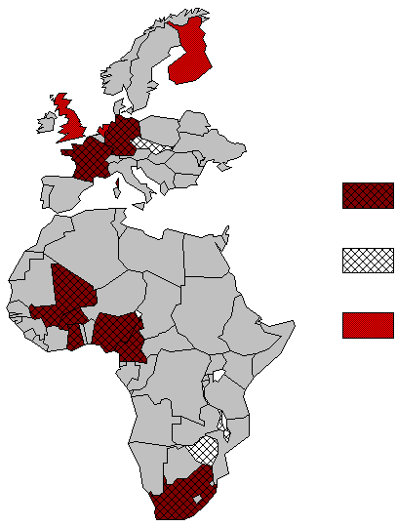
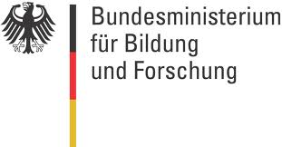

4 Extending Links: North-North/South-South/North-South
Levels of
collaboration:
Networks:
SA-GER CDR: RUB, UWC,
UNIMA, UZ
PhD & Masters‘
IPID: RUB, EUR, UEA
Masters‘
UrbanFoodplus: RUB, UKS, UGÖ, UFR, INERA, KNUST, UDS_T, UG, UO, IER, SHUMAS,
ABU and others.
Associated: UWC
PhD
EUSA_ID: RUB, UWC, UDE, EUR, UP, UoB I, UP I-PS, UJ, NMMU, UCT, UFH, UKZN, UoL
Notes:
Bochum Programme intakes nur alle zwei Jahre

Slide 11
Study Reform as Catalyst for Collaboration: RUB and UWC
Thanks for your attention!

