Slide 1
QS World University Rankings Evaluating Sustainability
Dr. Ludovic Highman
Strategic Rankings Consultant, QS
Associate Professor, University of Bath

Slide 2
Evaluating Sustainability
QS empowers students with independent insights on which global universities demonstrate excellence in a range of performance areas
Highlight Excellence
Benchmark
Against Peers
Trusted experience
Students increasingly expect universities to demonstrate progress on social and environmental issues
Rankings
Empower Students
QS enables universities to evaluate their performance, benchmark against peers and track across time
Understand Performance

Slide 3
Sustainability
Why is it important for universities?

Slide 4
Why universities?
“The education sector is one of the few sectors that can support, promote, and contribute to achieving all the 17 UN SDGs. Universities…are essential to achieving the SDGs because they can equip the next generation with the skills, knowledge, and understanding to address sustainability challenges and …research that advances the sustainable development agenda”
(Junior, Fien and Horne, 2019).

Slide 5
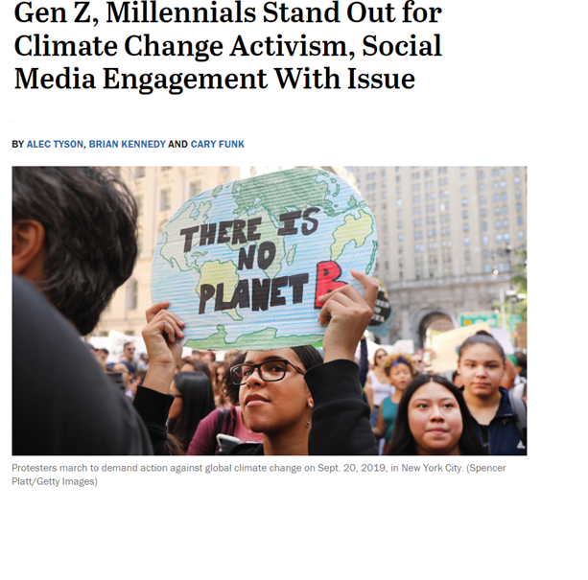
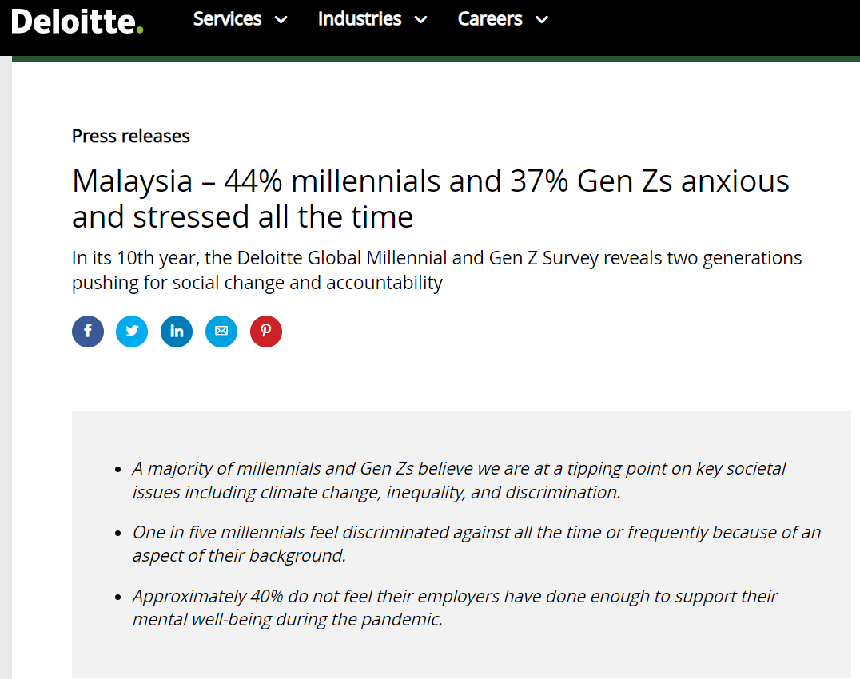
Students: expectations and demands
QS’s mission is to empower students with data and insights that will help them choose the right institution for them
The students of today will become the leaders of tomorrow. They expect change.

Slide 6
When applying to university, do Gen Z international students think about the track record of the institution on social issues such as environment, gender equality, minority rights and anti-racism?
Yes, these are very important considerations for me 47%
Yes, but only to some extent 39%
No, not really 14%

Slide 7
Most students
Sustainability
think of universities as being environmentally friendly
How important is it that universities take action?
88% of candidates claim it is ‘essential’ or ‘very important’ that their university takes action to reduce their environmental impact
But there is also an overwhelming perception that universities could
do more for the environment

Slide 8
So, what does it mean to be sustainable?
”Sustainable development is not a fixed state of harmony, but rather a process of change in which the exploitation of resources, the direction of investments, the orientation of technological development, and institutional change are made consistent with future as well as present needs” (Brundtland Report, World Commission on Environment and Development, 1987).

Slide 9
Ranking Design & Metrics

Slide 10
Outwards looking
If a university has committed to making a difference in the world, this difference should be visible outside of the university’s walls. We would see this in their alumni, in their research, in their reputation and in their performance in specific subjects.

Slide 11
Governance
Good governance is essential for any large body, corporate or public, to carry out its strategy effectively. It shows that the leadership is aligned, transparent and inclusive – and that checks and balances are in place.
Meeting the challenges facing the world requires governance throughout an institution’s operations, and we infuse this in our ranking.

Slide 12
Design features
Cross disciplinary approaches are being used to tackle global problems.
Research underpins much of the ranking. The strategic research focus can tell us a lot about an institution – not only its academic strengths but its direction, focus and mission
Does not require participation or direct submission – in line with our general rankings policy
It’s a dialogue. The conversation on sustainable development is ever changing. Feedback, advice and refinement is essential
National-level statistics are included – making it the first major ranking to link the higher education sector to wider national performance

Slide 13
Entry Criteria for Edition 1
Institutions with the greatest improvement in ranking have seen:
A published strategy on the university’s commitment to climate / environment
International faculty numbers, %
4.8%
10.4%
Eligibility for QS World University Ranking: multi-level, multi-faculty
International students, %
5.5%
14.1%
A minimum threshold of published papers aligned with SDG topics
Citations per faculty
5.1
27.6
2012
2019

Slide 14
Ranking Structure

Slide 15
Environmental Impact
50 %
Performance Lenses on Environmental Impact & Commitment of Universities
Sustainable Institutions
Sustainable Education
Sustainable Research
Alumni impact for innovation (sustainability)
AR score in subject rankings for subjects aligned with environmental impact (Earth & Marine Sc.; Env. Sc.)
Public policies on commitment to climate action + partnering with groups committed to climate action
Available courses on climate science & aligned curriculum
Impactful, highly-cited research on sustainable development relevant to the planet, environment and climate
National commitment to university sector (R&D as % of GDP)
Alumni impact in the policy sphere on environment (non-corporate)
Recording and reporting on key ESG datapoints
Staff perceptions on climate commitment
Research centre with sustainability focus
17.5 %
20 %
12.5 %
Notes:
This measure gives an indication into the impact of the university’s graduates and the extent to which they have helped industry and the corporate world to move to a more sustainable future. We took a sample of some of the major companies who are innovating in this field, and mapped where the key people involved with these companies graduated from. In order to estimate Alumni Impact for Innovation, we used only relevant awards / lists such as "30 Under 30: Social Entrepreneurs" by Forbes, "Stockholm Water Prize" by Stockholm Water Foundation, FT's 'Climate Leaders 2022’, etc.

Slide 16
Social Impact
50 %
Performance Lenses on the Social Impact of universities
Equality
Knowledge Exchange
Impact of Education
Gender ratios of the staff and student body
Alumni impact in Education sector
Research collaborations with universities in countries receiving ODA assistance
EDI policies, disability support, staff perceptions on equality
AR scores in subjects relating to social progress
Research on gender equality and equal opportunities (SDG 5,10)
Research partnerships with industry
Academic Freedom
UN/UNESCO data on gender pay gap, legal equality, wealth disparity, tolerance and acceptance
UN/UNESCO/World bank data on education system (graduation ratios)
15 %
10 %
10 %
Notes:
This metric is designed using our widely adopted research-based International Research Network (IRN) Index, however with no requirements on the volume of joint research publications and the number of their incoming citations. 2 dimensions: "Knowledge Exchange: Progress" and “Knowledge Exchange: Dissemination”

Slide 17
Social Impact contd.
Performance Lenses on the Social Impact of universities
Employability &
Opportunities
Life Quality
Employment outcomes
Research into health-related matters (SDG 1,2,3,6)
Employer Reputation
On-campus health provision
ER survey question (job preparedness)
UN/UNESCO/World Bank data on health outcomes
Research into decent work, (SDG 8,9,16)
Unemployment rate
10 %
5 %

Slide 18
Snapshot & Germany
700 INSTITUTIONS GLOBALLY
39 FROM GERMANY
1 IN TOP 150
12
In TOP 300

Slide 19
In Top 150
161 - 260
261 - 300

Slide 20
Timelines and Dates

Slide 21
Provisional 2023 calendar
January 2023
Inform universities of new sustainability data collection
Jan to April 2023
Collect data and support universities
April to August 2023
Validation and data refinements
August to Sep 2023
Analysis
Sep 2023
Governance
Dec 2023
Launch the 2nd Edition in December (possibly at ReImagine Education conference)

Slide 22
What steps can your institution take?
Study our indicators and submit data
If you know that a particular area will be a challenge, begin to strategize now – just as with improved WUR performance, it may take a bit of time but it will happen.
Speak to us! We have a support team who are eager to help advise. They can let you know if you meet the criteria, what’s missing, and key deadlines and definitions.

Slide 23
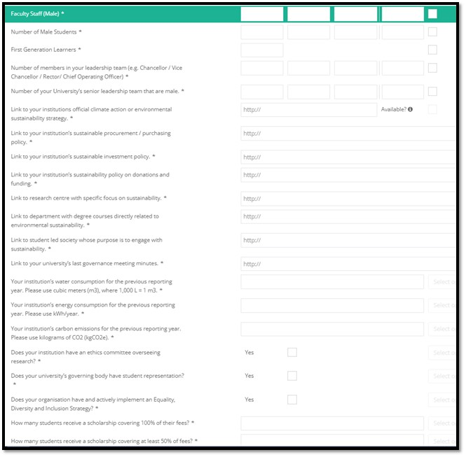
HUB
Fields
Data definition is available at Data Appendix - QS Quacquarelli Symonds

Slide 24
Direct Submit Data points | Evidence required
Policy referring to climate strategy | Web link
Evidence of an ethics committee | Web link
Published governance minutes | Web link
Sustainable procurement policy | Web link
Sustainable investment policy | Web link
Emissions, electricity, and water use data | Text / numerical entry, to specific definitions
Relevant degree courses | Web link
Sustainability research center | Web link
Disability support office | Web link
Female staff / student ratios | Text / numerical entry
Proportion of female leaders | Text / numerical entry
Student society with environmental focus | Web link
Equality, Diversity and Inclusion policy | Web link
Student representation on board | Web link

Slide 25
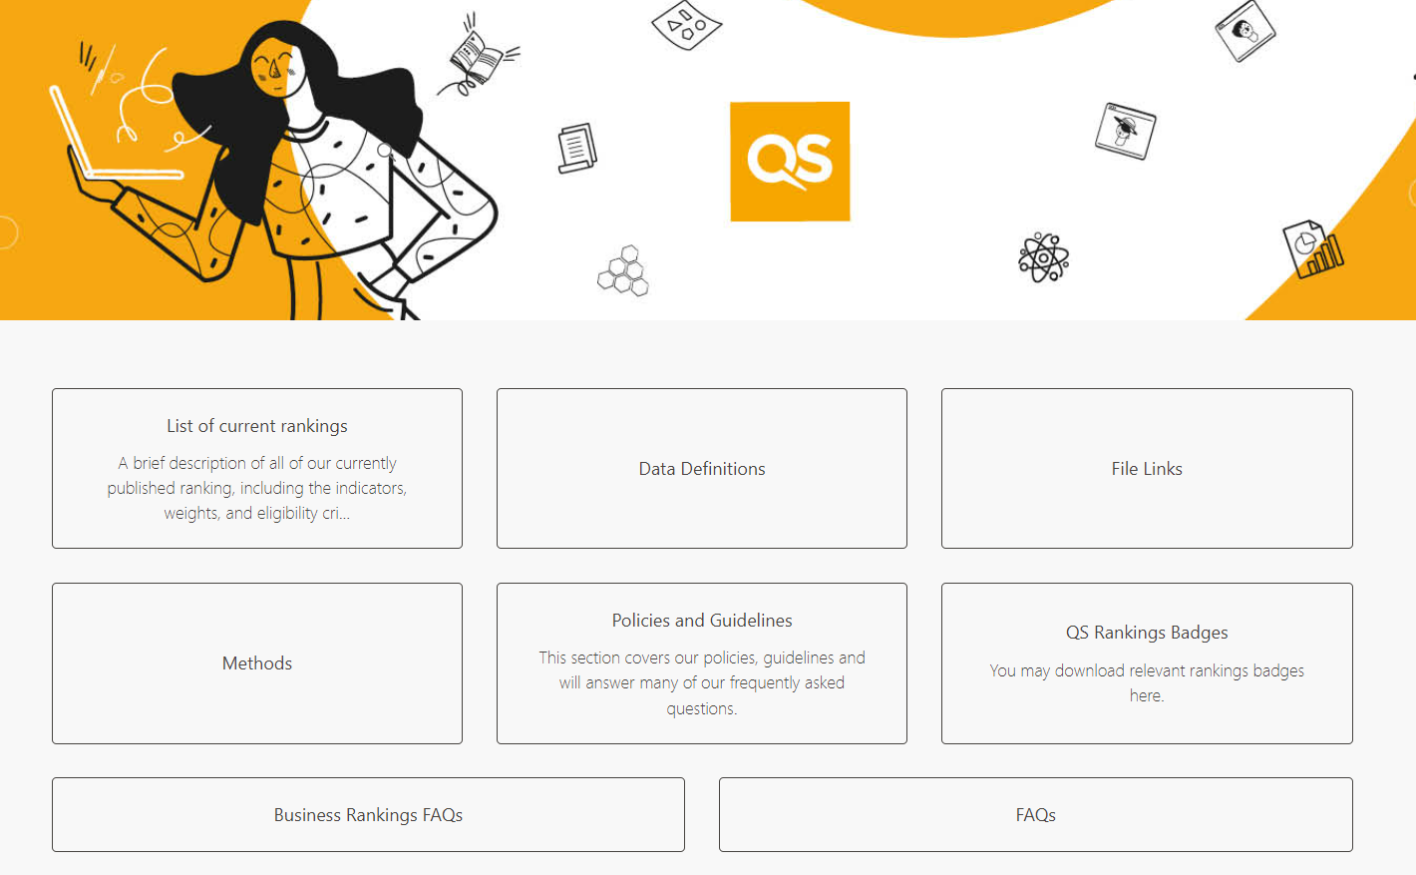
http://support.qs.com

Slide 26
With special thanks to

Slide 27
Further questions?
Please contact QS Support:
https://support.qs.com

